Slide 1
Java Comments, Literals, Keywords, Variables and data types
- Pranali chougule

Slide 2
Java Comments
1.Single-line Comments
These are used for brief explanations and span only one line.
They start with //.
2. Multi-line Comments:
3. Javadoc Comments:
These comments can span multiple lines.
They are enclosed within /* */.
These comments are used to document code and can be extracted to generate HTML documentation.
They are enclosed within /** */.

Slide 3
java Literals
Literals are fixed values that are assigned directly to variables. They represent constant values in the code and are categorized based on their type
Different types of Java literals:
1. Integer Literals
Decimal
Binary (Base 2)
Octal (Base 8)
Hexadecimal (Base 16)
2. Floating-point Literals
3. Character Literals
4. String Literals
5.Boolean Literals
6. Null Literal

Slide 4
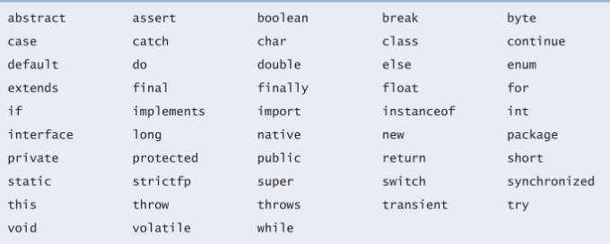
Java Keywords
In Java, keywords are reserved words that have predefined meanings and cannot be used as identifiers (such as variable names, method names, or class names).
These keywords serve specific purposes and are fundamental to the syntax and structure of Java programs.

Slide 5
Java Variables
A variable is a named memory location used to store data.
Each variable has a data type, which determines the size and type of the data it can hold.
Types of variables:
Local Variables:
Declared inside a method, constructor, or block.
Must be initialized before use.
Scope is limited to the block in which they're defined.
Instance Variables:
Declared inside a class but outside any method, constructor, or block.
Each object of the class has its own copy.
They do not need to be initialized explicitly
Static Variables:
Declared with the static keyword.
Shared by all instances of the class.
They also have default values and can be accessed directly by the class name.

Slide 6
Example
class Example {
int instanceVariable = 10; // Instance variable
static int staticVariable = 20; // Static variable
// Method to demonstrate local variables and instance variables
public static void main(String[] args){
int localVariable = 30; // Local variable
// Printing all variable types
System.out.println("Instance Variable: " + instanceVariable);
System.out.println("Static Variable: " + staticVariable);
System.out.println("Local Variable: " + localVariable);
} }

Slide 7
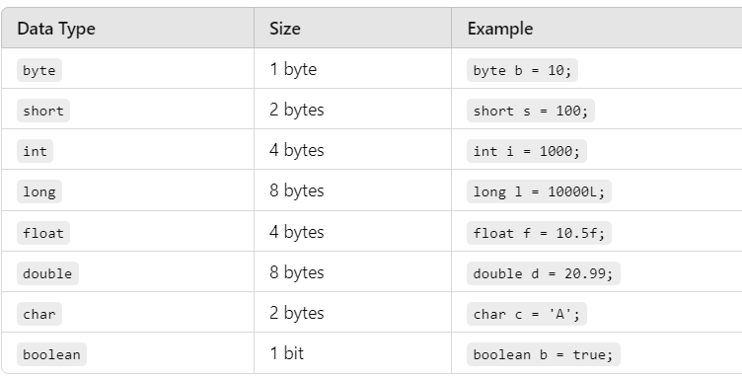
Data types
Data types in Java specify the type and size of data that can be stored in variables. They are divided into primitive and reference data types
1. Primitive data type:

Slide 8
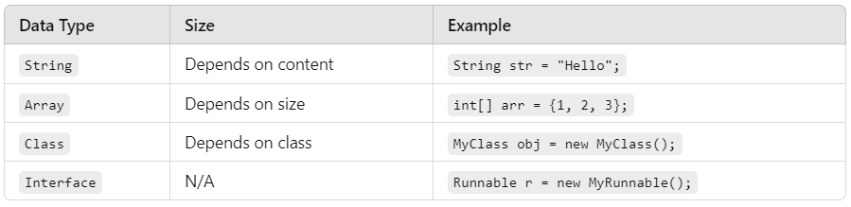
Non primitive data type:

